Slide 1

NetGenix Inc.
Business is our passion; Technology is our DNA.

Slide 2

Leadership Team
Vahag Karayan Co-founder and Executive Partner Vahag Karayan is an outcome and team-first driven technology executive with 20 years of experience in Market, Product & Program Management, Software Development, and Professional Services. He has deep knowledge in medical device product development. He has been recognized for his exceptional organizational leadership, customer/client management, and Agile coaching. Most recently he was the Head of Professional Services at Entertainment Partners and the Director of PMO, leading organizations' transformational journey and market entry offering SaaS solutions. His contributions helped EP's acquisition by TPG Capital in a multibillion-dollar transaction. Previously he led a major strategic program developing the next-generation Deep Brain Stimulation platform for Parkinson's disease at Boston Scientific. He has received recognition for his Software and hardware development on Mars Exploration Rovers while at NASA (JPL). Following which he won a Defense Advanced Research Projects Agency (DARPA) grant for “Expendable Local Area Sensors in a Tactically Interconnected Cluster” and served as the principal technologist for that program at Techfinity Inc. He also founded and operated an e-commerce start-up. His passion is leading organizations to solve life's smallest and most challenging problems through technology. Vahag is a triple UCLA Bruin and holds an MBA from UCLA Anderson, MS in Embedded Systems (Computer Science & EE) and BS in Electrical Engineering. | Gugo Martikyan Co-founder and Executive Partner Gugo Martikyan is an entrepreneur, a visionary technologist and a seasoned executive. He has over 20 years of experience in leading various size organization in designing, developing and delivering advanced technology solutions and technical operations. Gugo’s experience in technology and technology leadership spans a multitude of industries, including aerospace, energy, supply chain management, bioscience, software and finance. Gugo has been an instrumental leader in a spectrum of companies, ranging from startups to established Fortune 500s. Most recently, as Vice President of Technology at Entertainment Partners, Gugo spearheaded modernization and digital transformation efforts, defining and implementing company’s Enterprise Service and Data Strategies. He led technical due diligence teams in a number of Entertainment Partners acquisitions. Gugo’s contributions and leadership in the technology arena facilitated Entertainment Partners recent acquisition by TPG Capital in a multibillion-dollar transaction. As part of the initial team at Integrien, Gugo architected and delivered an enterprise-level software solution, paving the way for Integrien acquisition by VMWare for $103 million. Gugo holds a BS in Computer Science & Engineering from UCLA, as well as numerous other certifications and awards.

Slide 3
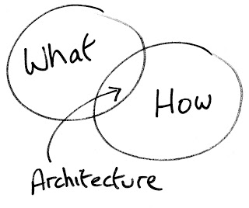
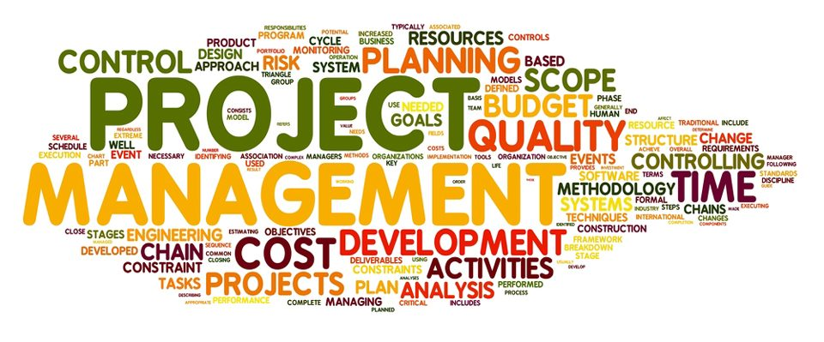
What we Do
Business Services
Business strategy review
Business Plan development
Market research & segmentation
Distribution channel development
Strategic & OEM partnerships
Corporate Development & Fundraising
M & A: business & technology due diligence
Product Services
Product Development
Digital Transformation
Cloud & Infrastructure
Architecture & Tech Platforms
Data services: Governance & Migration
DevOps Services
Technology debt assessment
Team Support
PMO Office setup, Project/Program Management
Team augmentation; Technology arm development
Agile workshops & training
Interim / Part-time CTO services
Interim / Part-time VP Business services
Executive & Leadership mentoring

Slide 4


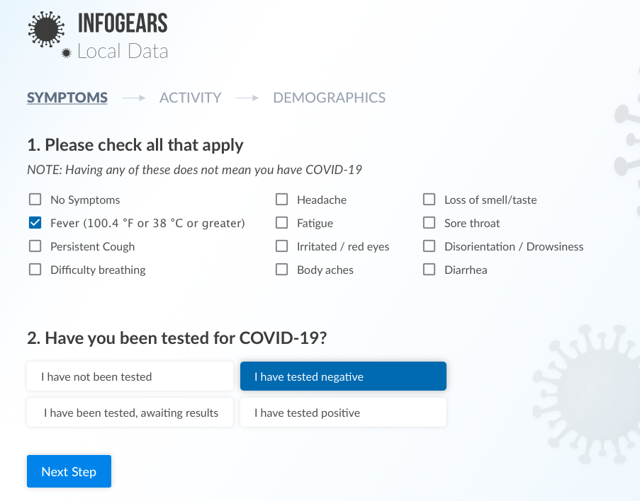

COVID-19 Local https://infogears.org/
Powered by NetGenix Inc. and Instigate Mobile
June 2020

Slide 5



Leverage your community
Human nature
Care for the family!
Care for Community/Locality ← This is what impacts us most, especially at critical times (COVID19 is a great example)
How are we leveraging the community to help itself?
What data are we collecting to make better decisions?
Care for the state
Care for the country

Slide 6
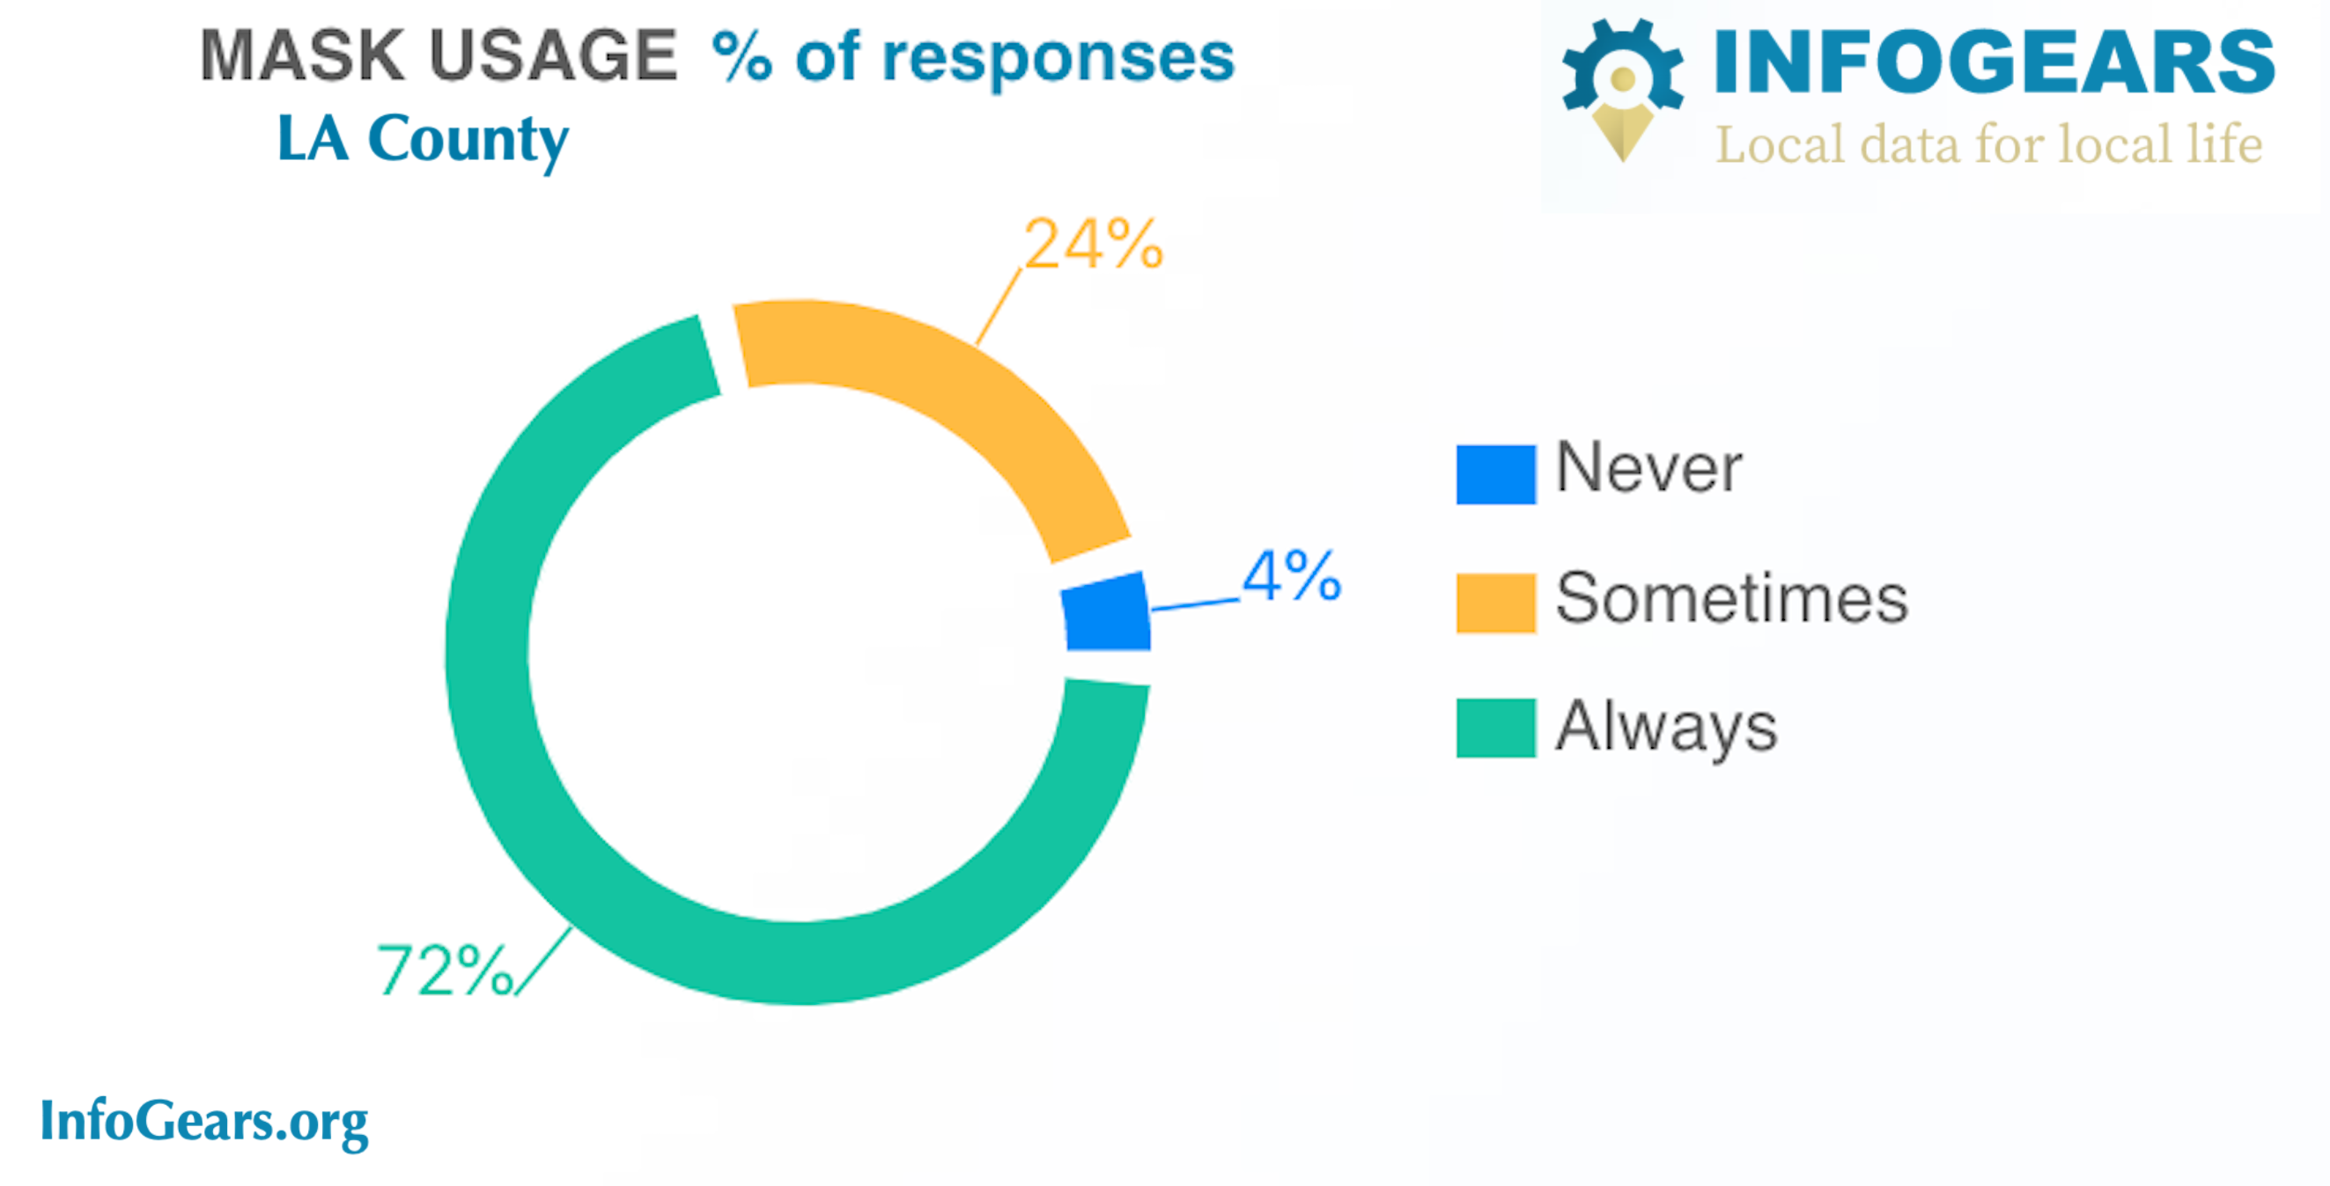
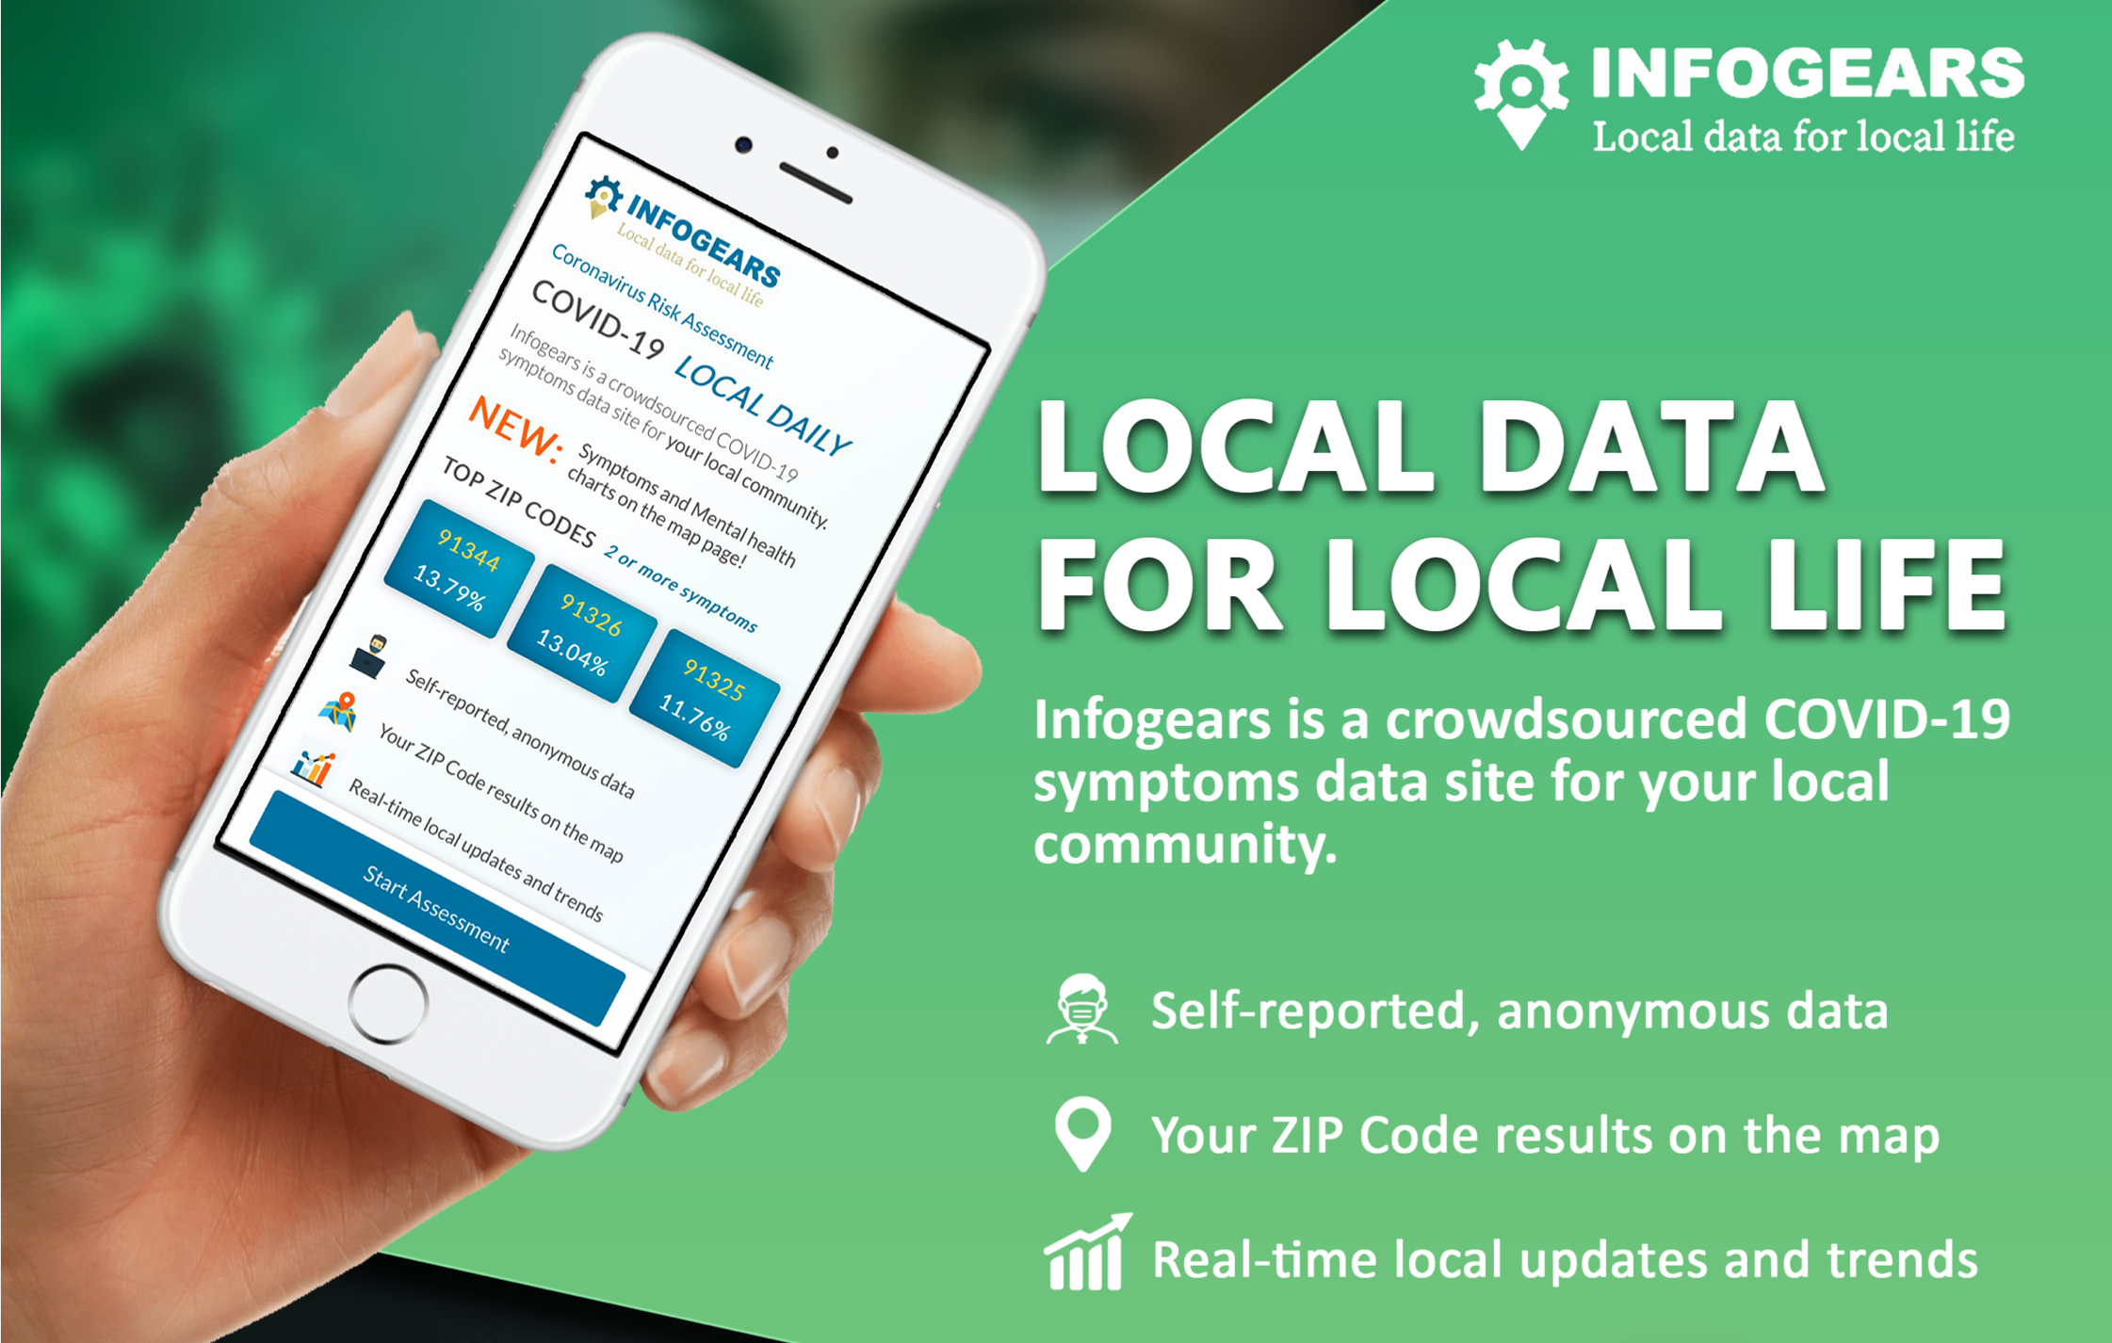
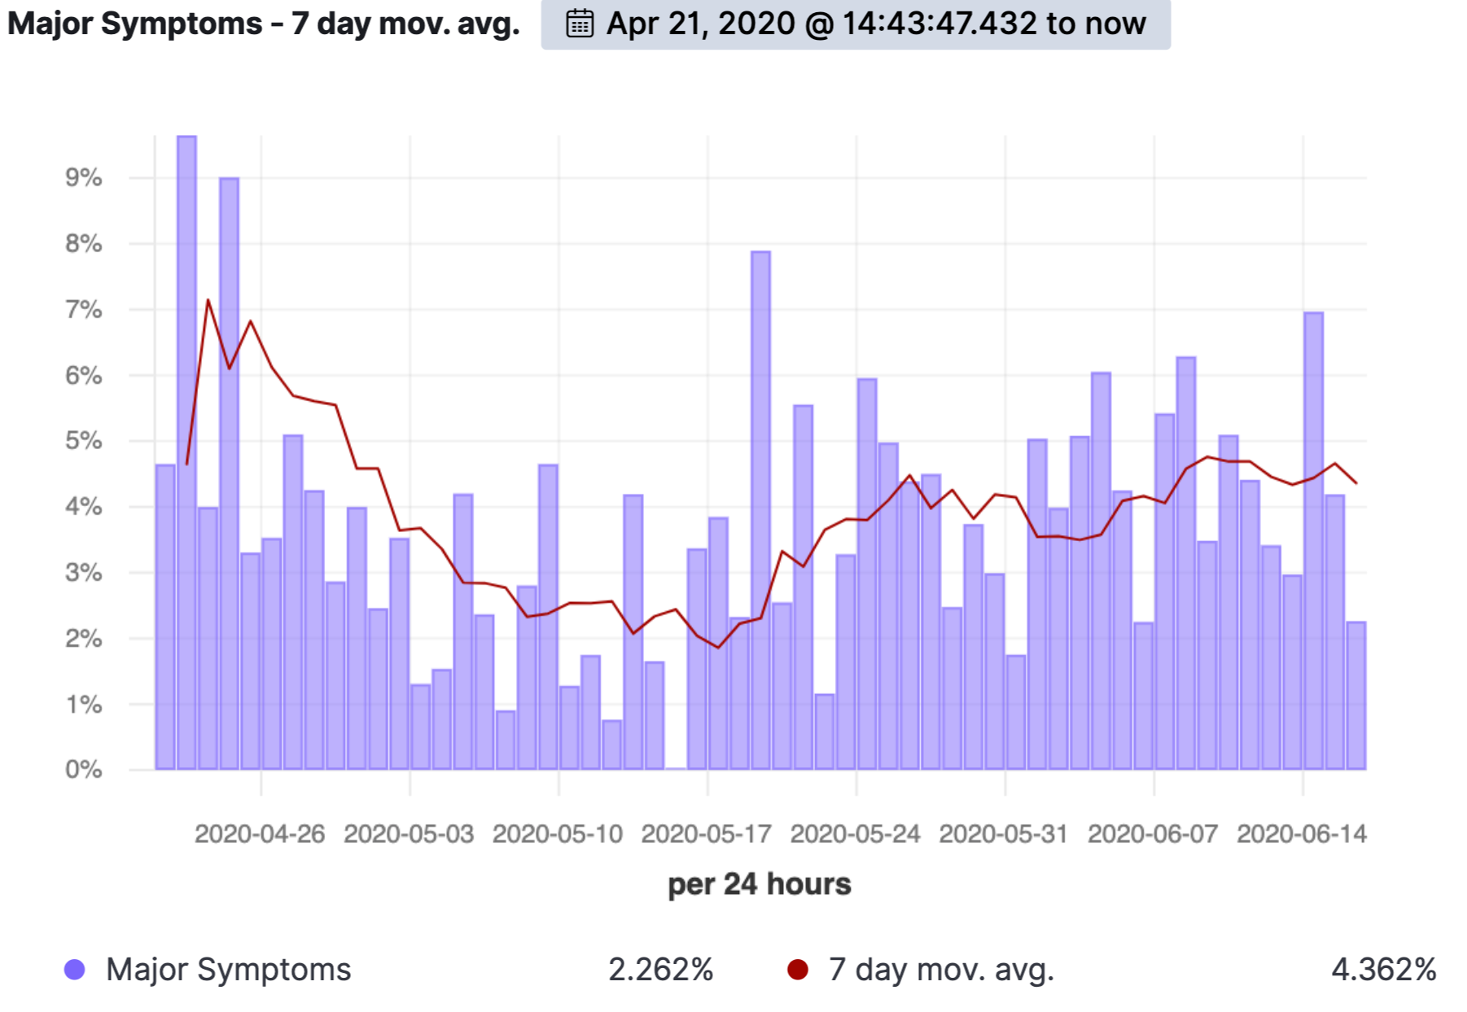
InfoGears.org by NetGenix
Live since 16Apr2020
Free Crowdsourced COVID19 local data platform
Help local communities track important data
Mask usage, Stay home, Symptoms, Mental Health
Leading indicator for COVID19 Hot Spots
Supported through
Streamlined Facebook advertising
Organic and social traffic
Investment
NetGenix time
Instigate Mobile time
Advertisements
AWS and other hosting
COVID Data Success?
Collected ~18,000 data points
Predicted increase in cases in May
Marriages are in trouble
65+ shelter at home !
What’s next?
Expansion to other localities
Hyper responsive opinion platform…
Expand self-reporting to more domains
LA Starts re-opening
Notes:
What’s next?
Expansion to other localities
Hyper responsive opinion platform…
Provide insights on current hot topics
Expand self-reporting to more domains
Citizen satisfaction, Noise level mapping, Traffic perception mapping, etc.

Slide 7
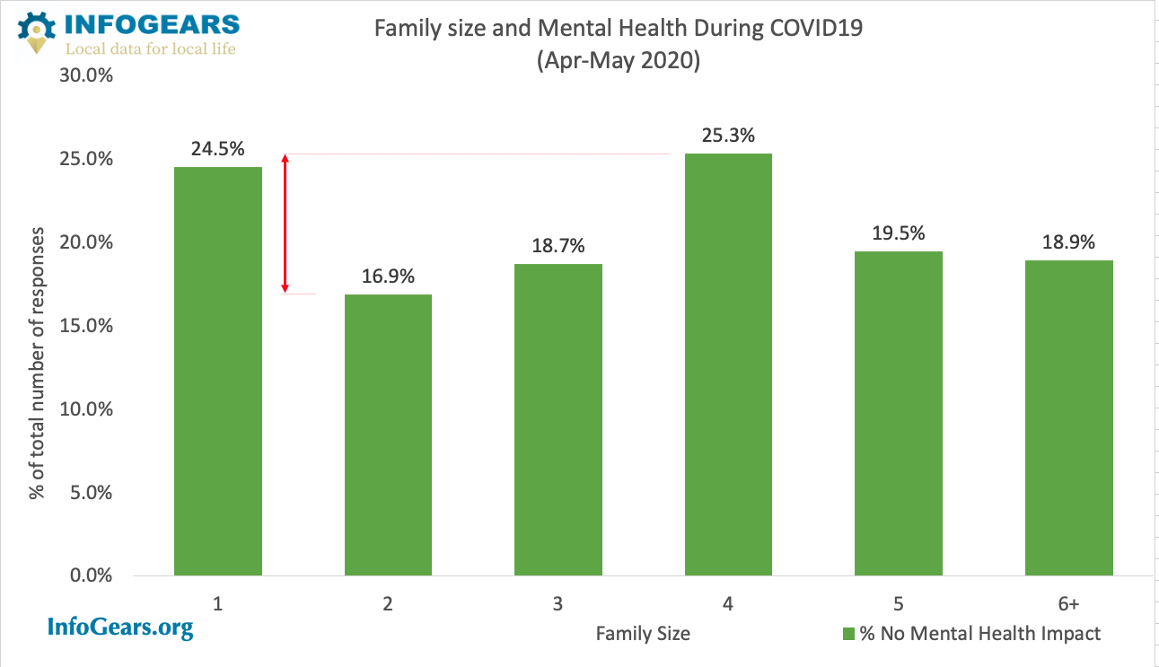
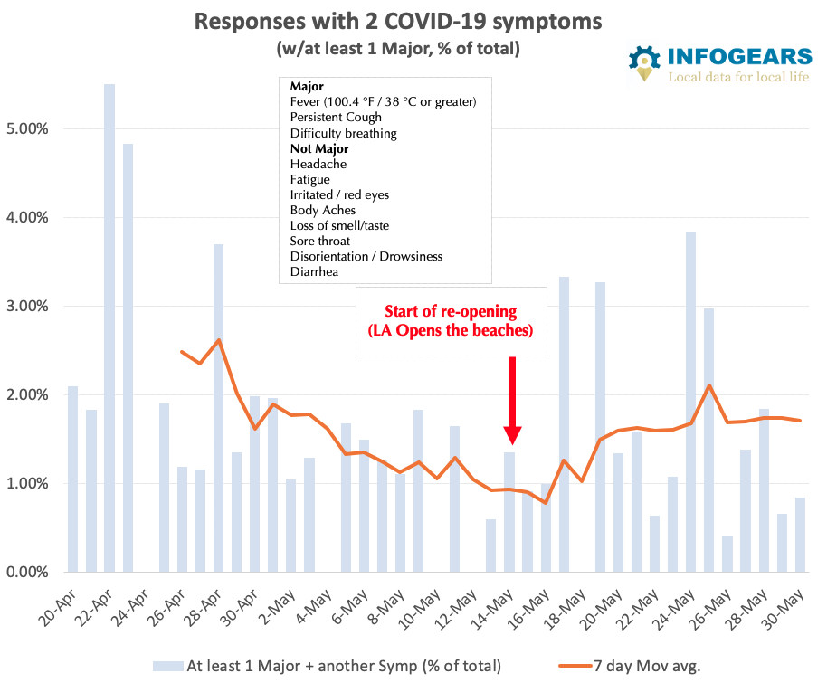
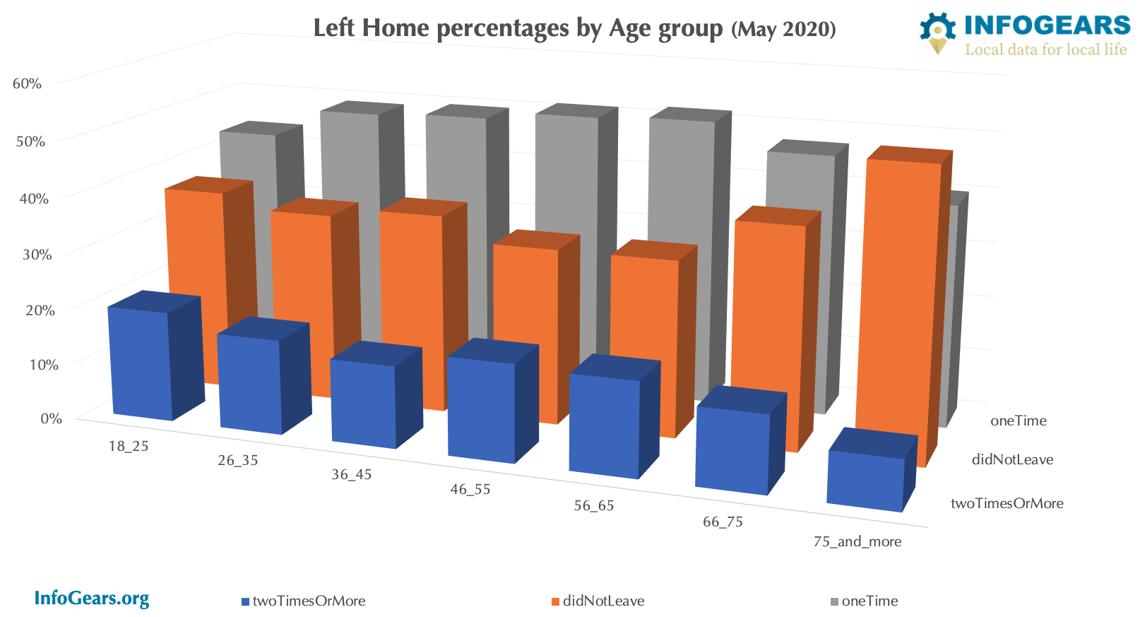
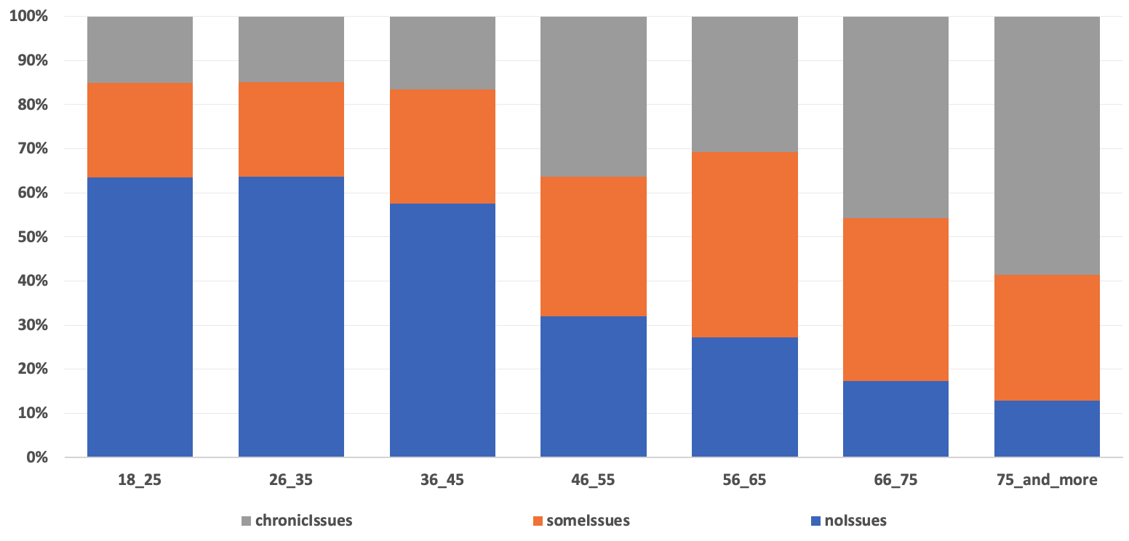
Basic Charts/Ideas
US is HUGE !
Notes:
What’s next?
Expansion to other localities
Hyper responsive opinion platform…
Provide insights on current hot topics
Expand self-reporting to more domains
Citizen satisfaction, Noise level mapping, Traffic perception mapping, etc.

Slide 8
Basic Charts/Ideas cont…
Our Hypothesis
Symptoms come before positive case identification therefore are predictive
Best Outcome
Predict Coming up Case increase or decrease in a local area
Other Cool Outcomes/Ideas
Mask effectiveness?
Significant Geographical differences? (on mask, mental health)
Any Interesting correlations with John Hopkins University Data
The Sky is the LIMIT!
Contact us when you have any questions!
Notes:
What’s next?
Expansion to other localities
Hyper responsive opinion platform…
Provide insights on current hot topics
Expand self-reporting to more domains
Citizen satisfaction, Noise level mapping, Traffic perception mapping, etc.

Slide 9
Thank you!
Contact
Vahag LinkedIn e-mail: vahag@netgenix.com
Gugo LinkedIn e-mail gugo@netgenix.com
Business is our passion; Technology is our DNA.

